Slide 1
Data Analytics - Lesson 6 Harvesting Data
Jeffrey Strickland, Ph.D.

Slide 2

What is Required by Data Analytics?
Integrate
Analyze
Visualize
V1 | V2 | V3 | V4
1 | 14.23 | 1.71 | 2.43
1 | 13.20 | 1.78 | 2.14
1 | 13.16 | 2.36 | 2.67
1 | 14.37 | 1.95 | 2.50
1 | 13.24 | 2.59 | 2.87
https://portal.azure.com/#dashboard/private/6245138c-3a35-4e4f-8cf6-d8fe27b9b026

Slide 3
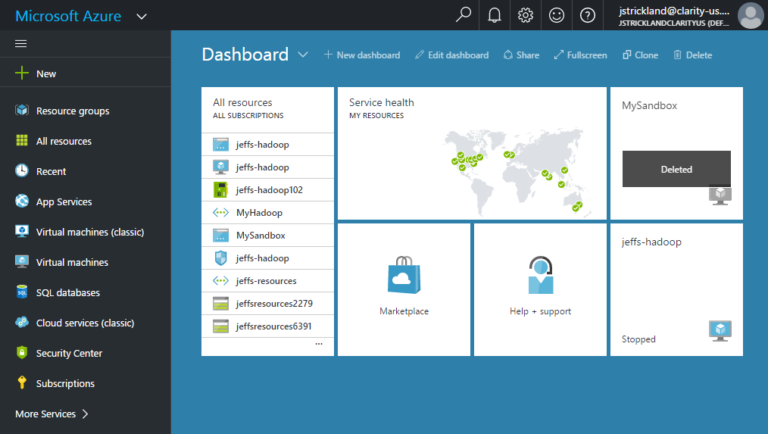
My Hadoop – Azure Dashboard
My Resources
Regional Service Health
Help and Support
Virtual Machine Status
My Virtual Machiines

Slide 4
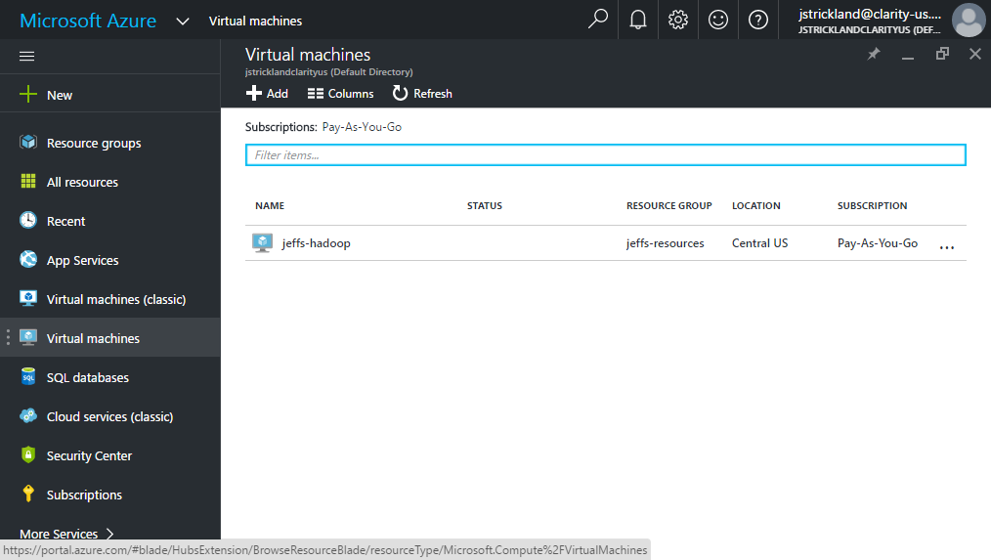
My Virtual Machine – Azure Dashboard

Slide 5
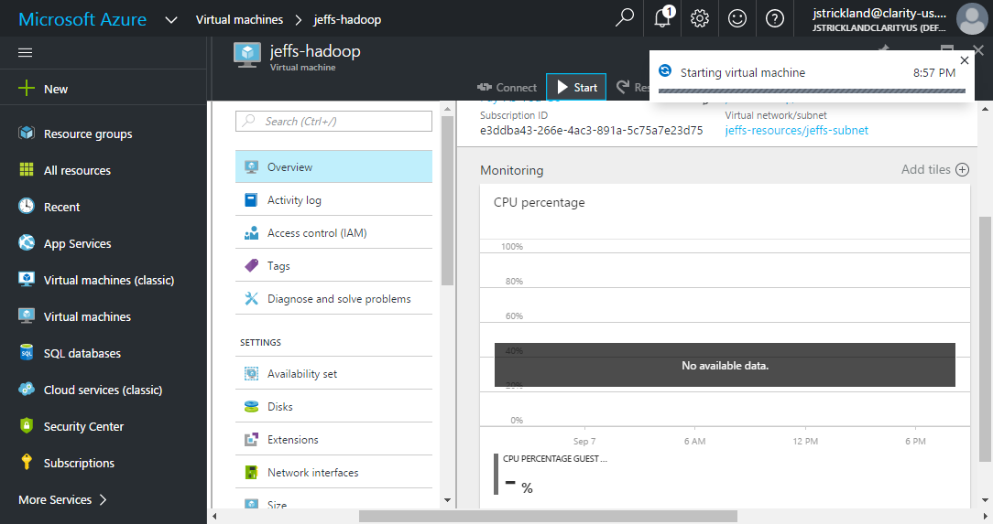
My Hadoop Cluster Start-up
Start the Cluster
Status

Slide 6
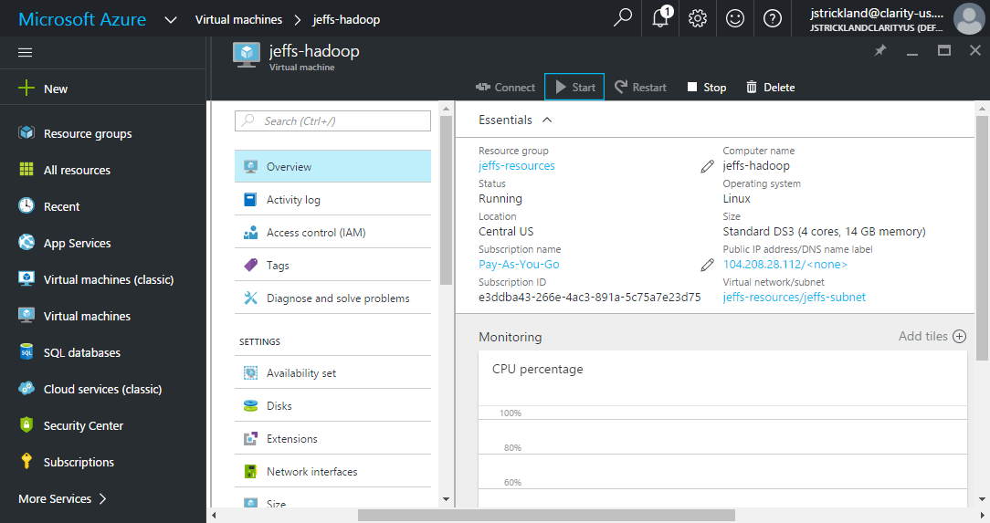
My Hadoop Cluster Running
Configuration
Status
Subscription
Standar DS3 (4 Cores, 14 GB memory)
IP Adress
The more CPU cores and disk drives that have a piece of my data mean more parallel processing power and faster results.

Slide 7
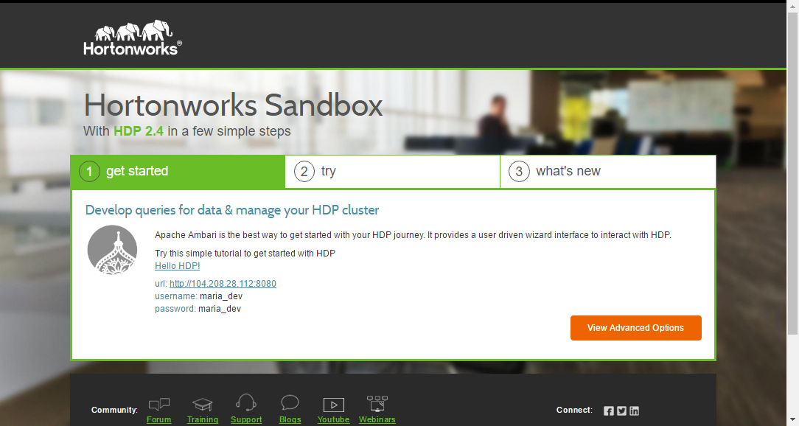
My Hadoop Sandbox @ http://104.208.28.112:8888/
Enter in Browser
Click Here

Slide 8
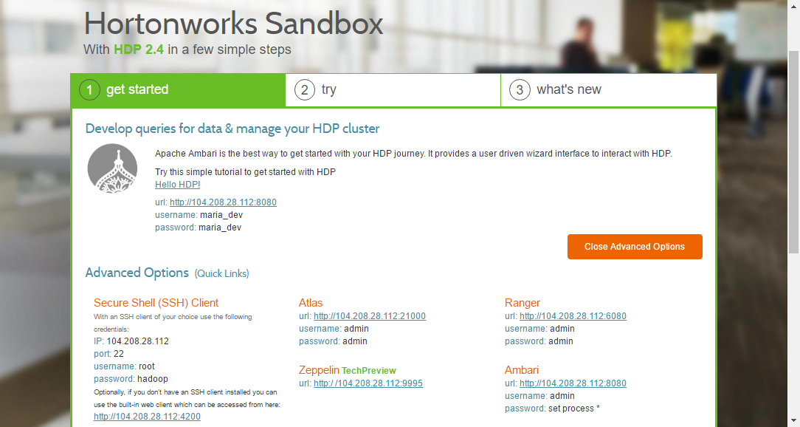
My Hadoop Sandbox Advanced Options
Click Hyperlink

Slide 9
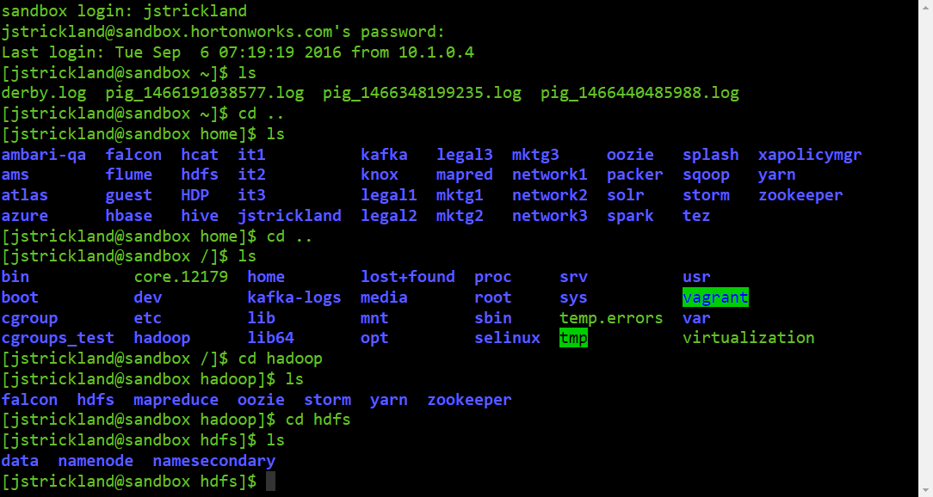
My Secure Shell (SSH) Client

Slide 10
My Hadoop Sandbox Advanced Options
Click Hyperlink

Slide 11
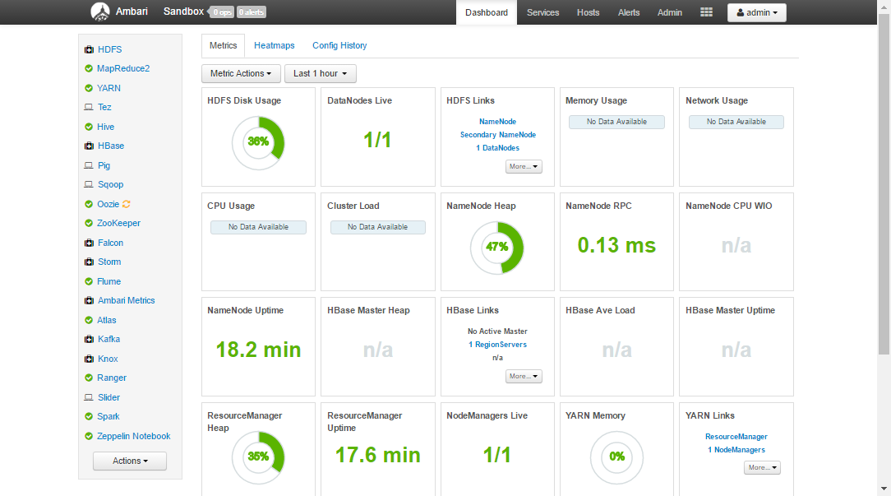
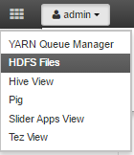
My Ambari Dashboard
HDFS Usage
Name Node Heap
Name Node Remote Procedure Call (RPC)
Name Node Uptime
Resource Manager Heap

Slide 12
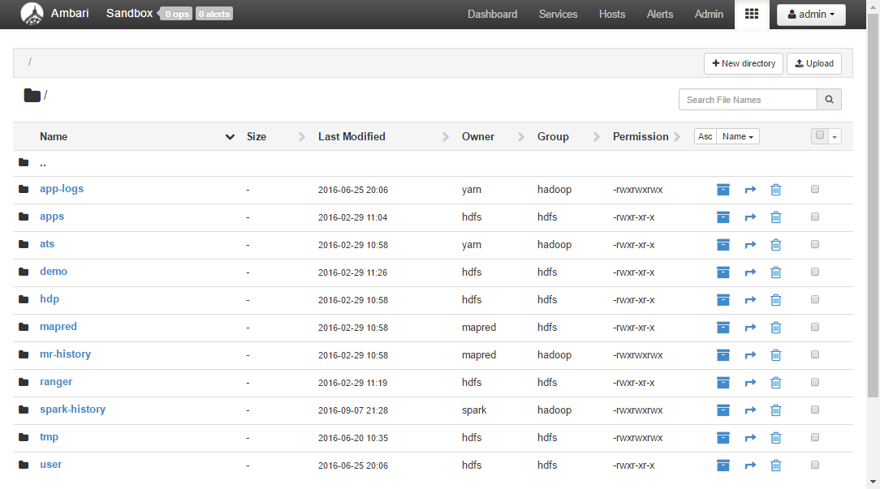
My HDFS Directory
File Upload
Apps Sub-Directory
Move File Icon
User Sub-Directory
Rear/Write Permissions

Slide 13
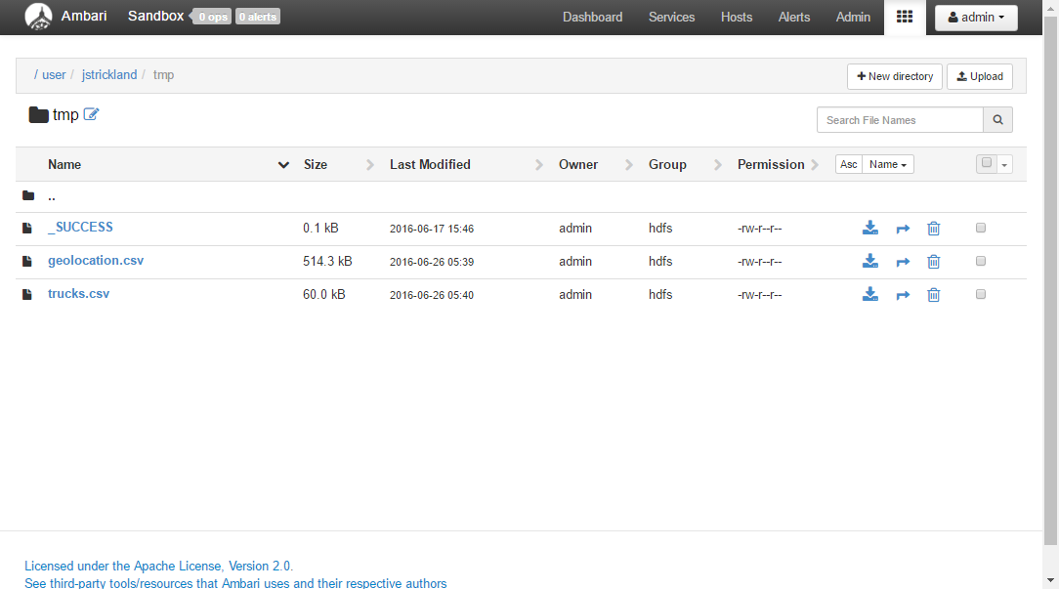
HDFS Data Files Uploaded for Exercises
Apps Sub-Directory
Data Files:
geolocation.csv
trucks.csv
Usage
Calculate new fields: average_miles, driver_hours
Analyze: Riskfactor

Slide 14
The Distributed File System: HDFS
While processing a file in Hadoop ecosystem, it gets converted into a block or gets split into multiple blocks depending upon the size of the file. Each block is made up of a default size of 64 MB
Here the file that comes for processing has a size of 512 MB.
Hadoop will convert it into 8 different blocks, each with 64 MB size
Now instead of this file, 8 different blocks would be processed by Hadoop.
File Size = 512 MB
Block Size = 64 MB
Block Size = 64 MB
Block Size = 64 MB
Block Size = 64 MB
Block Size = 64 MB
Block Size = 64 MB
Block Size = 64 MB
Block Size = 64 MB

Slide 15
Hadoop Racks
switch
Single Hadoop cluster may have one or more Racks depending on the size of the cluster
switch
switch
switch
Name Node
Data Node 1
Data Node 5
Data Node 9
B
A
A
C
C
B
Rack Aware
metadata
Data Node 2
Data Node 6
Data Node 10
Rack 1:
Data Node 1
Data Node 2
Data Node 3
Rack 5:
Data Node 5
Data Node 6
Dta Node 7
Email.txt
Blk A
DN1, DN5, DN6
Blk B
DN7, DN1, DN2
Blk C
DN5, DN8, DN9
B
A
C
Data Node 3
Data Node 7
Data Node 11
Data Node 5
Data Node 8
Data Node 12
Rack 1
Rack 5
Rack 9
We have taken care of two things –
Data Node Failure
If any of the Data Node goes down then data would be available in other two Data Nodes.
Rack Failure
In this case if one of the Racks (Even the Rack with two Data Nodes) goes down then our data would be available over other Rack (With one Data Node).
In both the scenarios our data is safe and it will continue to ensure availability.

Slide 16
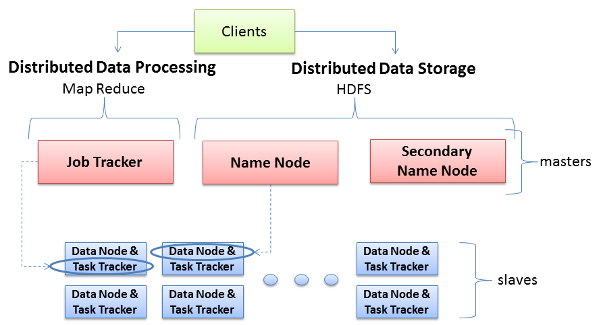
Hadoop Server Roles
NameNode stores MetaData (No of Blocks, On Which Rack which DataNode the data is stored and other details) about the data being stored in DataNodes whereas the DataNode stores the actual Data.
Secondary NN contains the name space image, edit log files' back up for past one hour (configurable). And its work is to merge latest Name Node NameSpaceImage and edit logs files to upload back to Name Node as replacement of the old one
Technical Sense: JobTracker is a master which creates and runs the job. JobTracker which can run on the NameNode allocates the job to TaskTrackers which run on DataNodes; TaskTrackers run the tasks and report the status of task to JobTracker.
two key functional pieces
Oversees and coordinates the parallel processing of data
Client is going to break the data file into smaller “Blocks”, and place those blocks on different machines throughout the cluster. The more blocks I have, the more machines that will be able to work on this data in parallel.
Oversees and coordinates the data storage function (HDFS)
Physical Sense: The JobTracker runs on MasterNode aka NameNode whereas TaskTrackers run on DataNodes.

Slide 17
Structured Query Language (SQL)
SQL stands for Structured Query Language
SQL lets you access and manipulate databases
SQL became a standard of the American National Standards Institute (ANSI) in 1986, and of the International Organization for Standardization (ISO) in 1987

Slide 18
What can SQL do?
SQL can execute queries against a database
SQL can retrieve data from a database
SQL can insert records in a database
SQL can update records in a database
SQL can delete records from a database
SQL can create new databases
SQL can create new tables in a database
SQL can create stored procedures in a database
SQL can create views in a database
SQL can set permissions on tables, procedures, and views

Slide 19
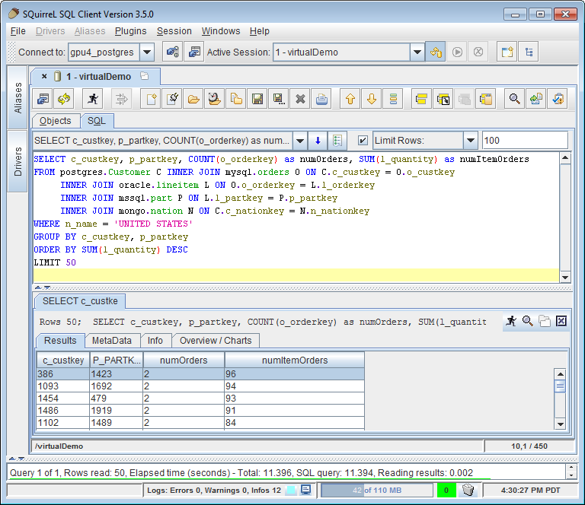
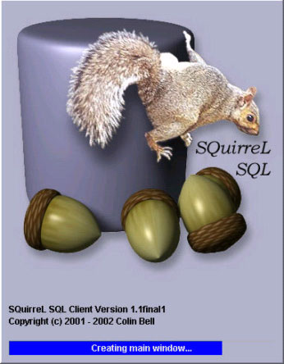
SQuirreL

Slide 20
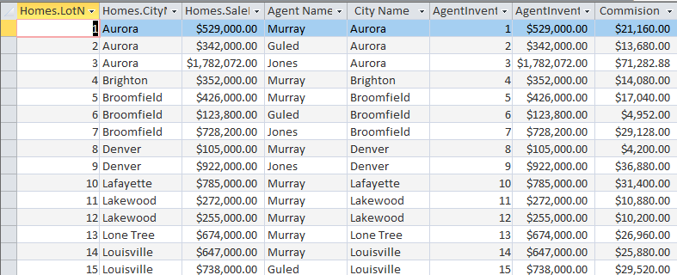
SQL EXAMPLE 1
SELECT *
FROM Homes INNER JOIN AgentInventory ON Homes.[LotNumber] = AgentInventory.[LotNumber]
ORDER BY Homes.LotNumber;

Slide 21

SQL Example 2
TRANSFORM Sum(AgentInventory.SalePrice) AS SumOfSalePrice
SELECT AgentInventory.AgentName, Sum(AgentInventory.SalePrice) AS [Total Sale Price], Count(AgentInventory.SalePrice) AS [Property Count]
FROM AgentInventory
GROUP BY AgentInventory.AgentName
PIVOT AgentInventory.[CityName]="Aurora";

Slide 22
SQL Table Creation
Create a New Table
CREATE TABLE Persons ( PersonID int, LastName varchar(255), FirstName varchar(255), Address varchar(255), City varchar(255) );
Create a Table from a Table
CREATE TABLE new_table_name AS SELECT membnr, tenure, age,... FROM customer_data WHERE age >= 21;

Slide 23
Contact Information
E-mail: jeff@humalytica.com
LinkedIn: https://www.linkedin.com/in/jeffreystrickland
Web site: www.humalytica.com
Skype: jeffrey.strickland2

